Slide 1
Reasoning about Dominance:
the green area dominates in high dimensions

Slide 2
Notes:
Cech Segments minus 1 diamond plus 2 big pie. Theta inside, phi outside

Slide 3
φ
θ
Notes:
Cech Segments minus 1 diamond plus 2 big pie. Theta inside, phi outside

Slide 6
PRUV Talk: how we describe the volumes

Slide 7
s
r
Notes:
Cech Intersection of spheres

Slide 8
Notes:
Cech Intersection of spheres

Slide 9
Notes:
Cech Intersection of spheres

Slide 10
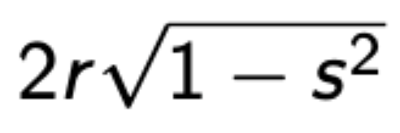
x
Notes:
Cech Intersection of spheres

Slide 11
VoR Čech

Slide 12
s
r
φ
Notes:
Doodles

Slide 13
r
r(sinφ)
r(sinφ)
x
φ
r
Notes:
Cech Intersection of spheres

Slide 14
x
Notes:
Cech Intersection of spheres

Slide 15
VoR Rips

Slide 16
s
2r
Notes:
Doodles

Slide 17
2r(sinθ)
2r(cosθ)
2r
θ
Notes:
Doodles

Slide 18
2r(sinθ)
x
2r(cosθ)
2r
θ
Notes:
Rips Intersection of spheres

Slide 19
Notes:
Rips Intersection of spheres

Slide 20
d in r, 2r

Slide 22
θ’
Notes:
Rips Intersection of spheres

Slide 23
φ
θ
Notes:
Cech Segments minus 1 diamond plus 2 big pie. Theta inside, phi outside

Slide 24
d in 0,r

Slide 25
Notes:
Rips Intersection of spheres

Slide 26
Notes:
Cech quadrants minus diamond plus 2 big pies

Slide 27
Argument from literature

Slide 28
60º
Notes:
Cech quadrants minus diamond plus 2 big pies

Slide 29
θ
r
Notes:
Cech quadrants minus diamond plus 2 big pies

